Slide 1
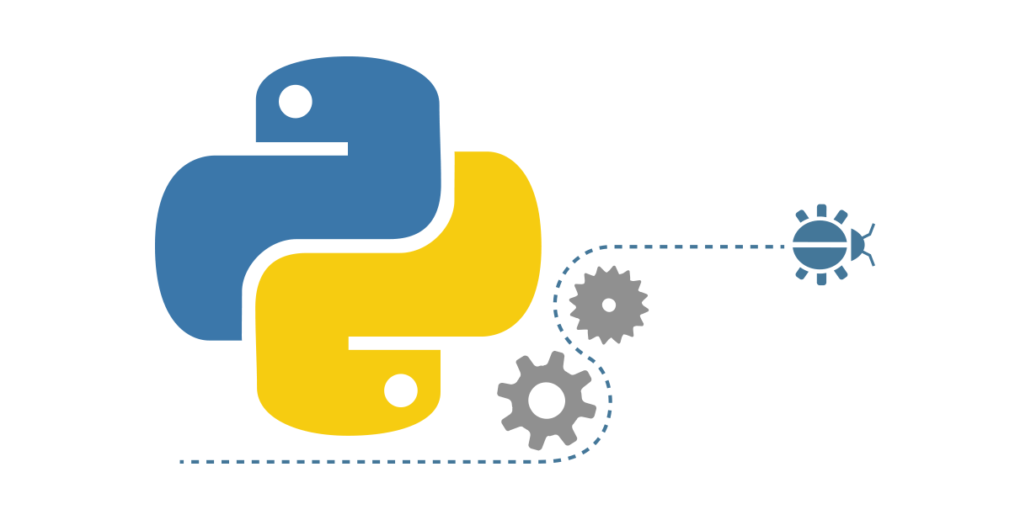

Introduction to Programming Using Python

Slide 2
Literals
Literals are constant numeric or non-numeric values which are assigned to a variable or used anywhere else in a program are called literals.
Ex:
"Hello World!!"
"@333"
3442
4.2

Slide 3
Delimiters
Delimiters are symbols which are used to separate values or parts of a program. They are also used to enclose values between them.
Ex:
()
{}
:
;

Slide 4
Comments
Comments are statements which are ignored by the interpreter. They do not have any effect on the execution of the program.
Ex:
# Hello from the program
# This is a comment.
# New comment

Slide 5
Datatypes
Datatypes can be categorized into five different categories:
Number
Sequences
Sets
Mappings
None

Slide 6
Numbers
There are four datatypes which reside in this category:
Integer
Float / Floating point
Boolean
Complex

Slide 7
Sequences
There are three kinds of datatypes which reside in this category:
String
List
Tuple

Slide 8
Set
Set is a collections of unique values. The collection is unordered in nature.
Ex:
{1,2,4,5}
{2,6,7,9}

Slide 9
Mapping
There is one datatype which resides in this category.
Ex:
{"key1": "value1", "key12" : "value2" }
{"key2" : "value2"}

Slide 10
None
None is a special datatype which signifies the absence of any value.
Ex:
a = None
b = None

Slide 11
Some important functions
Function is a group of statements in python which perform a specific task.
Some important functions are:
type() - used to output the type of an identifier.
Id() - used to output the address of the variable.
print() - display something on the screen.

